Slide 1
ECC support in DNSSEC-validating Resolvers
Geoff Huston, George Michaelson
APNIC Labs
October 2014

Slide 2
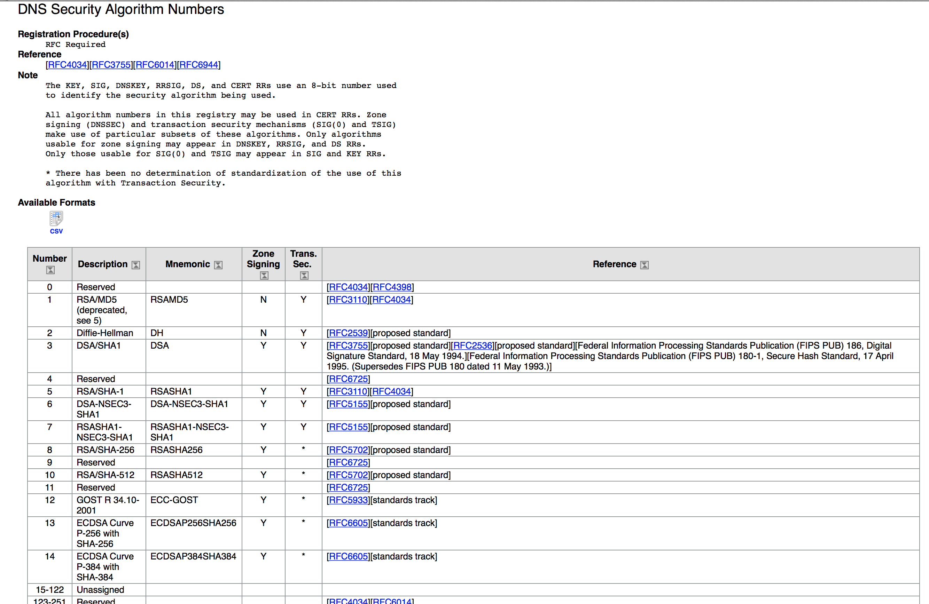

Slide 3
Background Questions
  Is ECC a “well supported” crypto protocol?
  Is it a reasonable candidate crypto protocol for use as the signing algorithm for the root key of the DNS?
  Is ECC as widely supported as RSA?

Slide 4
The ECC Question
  Is there a clear signal of a set of DNS resolvers who are evidently performing DNSSEC validation using RSA-based crypto algorithms, but fail to understand ECC?

Slide 5
The Test Environment
We used the Google Ad network to deliver a set of DNS tests to clients to determine whether (or not) they use DNSSEC validating resolvers
We used 4 tests:
  no DNSSEC-signature at all
  DNSSEC signature using RSA-based algorithm
  DNSSEC signature using broken RSA-based algorithm
  DNSSEC signature using ECC-based algorithm

Slide 6
The Test Environment
Unsigned
d.t10000.u2045476887.s1412035201.i5053.vne0001.4f167.z.dashnxdomain.net
e.t10000.u2045476887.s1412035201.i5053.vne0001.4f167.z.dotnxdomain.net
f.t10000.u2045476887.s1412035201.i5053.vne0001.4f168.z.dotnxdomain.net
g.t10000.u2045476887.s1412035201.i5053.vne0001.4f167.y.dotnxdomain.net
RSA Signed
RSA signed (Badly)
ECC-Signed
Mapped to a wildcard in the zone file
Unique Signed
Zone

Slide 7
A Naïve View
A non-DNSSEC-validating resolver query:
A DNSSEC-Validating resolver query:
A?
Single A Query
DNS Forwarders
A
A + EDNS0(DNSSEC OK)?
DS + EDNS0(DNSSEC OK)?
DNSKEY + EDNS0(DNSSEC OK)?
DNS Forwarders
A + RRSIG
DS + RRSIG
DNSKEY + RRSIG
A, DS, DNSKEY Queries

Slide 8
DNSSEC Validation Queries
e.t10000.u2045476887.s1412035201.i5053.vne0001.4f167.z.dotnxdomain.net
Query for the A resource record with EDNS0, DNSSEC-OK
query: e.t10000.u204546887.s1412035201.i5053.vne0001.4f167.z.dotnxdomain.net IN A +ED
Query the parent domain for the DS resource record
query: 2f7b3.z.dotnxdomain.net): query: 4f167.z.dotnxdomain.net IN DS +ED
Query for the DNSKEY resource record
query: 2f7b3.z.dotnxdomain.net): query: 4f167.z.dotnxdomain.net IN DNSKEY +ED

Slide 9
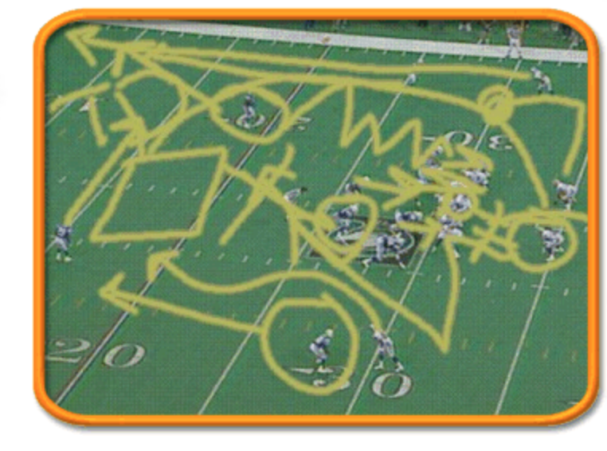
What We See

Slide 10
The DNS is (really) messy
The DNS is a non-deterministic environment, and the signals one sees at resolvers and servers can be incredibly confusing
We are priming each client with a unique DNS name, and watching the DNS query traffic that appears on the only authoritative server for that name
What we see are a variety of query patterns that reach our authoritative name server

Slide 11
What We See (a small random sample)
3fb0f.1410333 queries:AADD
5c323.1410361 queries:a
660e3.1410366 queries:aA
415ad.1410383 queries:A
733e3.1410317 queries:AADK
6dce7.1410371 queries:A
3d2c5.1410325 queries:A
5b739.1410360 queries:A
5be73.1410361 queries:A
557e1.1410350 queries:AAa
46693.1410334 queries:a
702b7.1410373 queries:a
3f1ab.1410332 queries:ADK
70b99.1410314 queries:AA
6d4dd.1410372 queries:AADDKK
585b3.1410359 queries:AA
49d2f.1410393 queries:ADAAADAADAADADAAAA
3f731.1410329 queries:ADK
4cc9d.1410339 queries:A
47877.1410338 queries:a
489f5.1410337 queries:A
4b439.1410349 queries:A
77829.1410325 queries:ADK
5ebf5.1410360 queries:A
5f6f1.1410362 queries:A
49261.1410337 queries:a
4e5ff.1410341 queries:A
413db.1410332 queries:a
5a5cd.1410357 queries:ADKADK
73129.1410375 queries:A
78a73.1410385 queries:A
47459.1410336 queries:A
48a8f.1410337 queries:AKD
72fed.1410317 queries:AAa
5b6cb.1410362 queries:AAaA
76bf9.1410324 queries:aA
A = A + DNSSEC-OK a = A without DNSSEC-OK

Slide 12
Why Do We See What We See?
The DNS has no “trace” in its queries to help diagnosis
Clients use multiple name servers, and use local timeouts to repeat the query
Resolvers may use server farms, so that queries from a common logical resolution process may be presented to the authoritative name server from multiple resolvers, and each resolver may present only a partial set of validation queries
Resolvers may use forwarding resolvers, and may explicitly request checking disabled to disable the forwarding resolver from performing validation itself
Clients and resolvers have their own independent retry and abandon timers

Slide 13
First Approach to answering the ECC question – Statistical Inference
A DNSSEC-aware resolver encountering a RR with an attached RRSIG that uses a known algorithm will query for DS and DNSKEY RRs
A DNSSEC-aware resolver encountering a RR with an attached RRSIG that uses an unknown/unsupported crypto algorithm appears not to query for the DNSKEY RRs

Slide 14
Results
Over 22 days in September 2014 we saw:
  3,773,420 experiments
  937,166 experiments queried for the DNSKEY RR of a validly signed (RSA) domain (24.8%)
  629,726 experiments queried for the DNSKEY RR of a validly signed (ECC) domain (16.6%)
If we assume that the DNSKEY query indicates that the resolver “recognises” the protocol, then it appears that there is a fall by 8.2% in validation when using the ECC protocol
1 in 3 RSA experiments that fetched the DNSKEY did not fetch the ECC DNSKEY

Slide 15
Results
Over 22 days in September 2014 we saw:
  3,773,420 experiments
  937,166 experiments queried for the DNSKEY RR of a validly signed (RSA) domain (24.8%)
  629,726 experiments queried for the DNSKEY RR of a validly signed (ECC) domain (16.6%)
If we assume that the DNSKEY query indicates that the resolver “recognises” the protocol, then it appears that there is a fall by 8.2% in validation when using the ECC protocol
1 in 3 experiments that fetched the DNSKEY in RSA did not fetch the ECC DNSKEY

Slide 16
Hmmm
How does this relate to affected users?
How do validating resolvers manage an unrecognised algorithm failure?
Lets try again and look at both DNS query and web log data

Slide 17
DNS resolver failure modes for an unknown signing algorithm
If a DNSSEC-Validating resolver receives a response RRSIG with an unknown crypto algorithm does it:
  Immediately stop resolution and return a status code of SERVFAIL?
  Fetch the DS RR and then return a status code of SERVFAIL?
  Fetch the DS and DNSKEY RRs and then return a status code of SERVFAIL?
  Or does it abandon validation, query without the DO bit and just return the unvalidated query result?

Slide 18
Second Approach to answering the ECC question – DNS + WEB
Data collection: 10/9/14 – 4/10/14
552,104 clients who appear to be exclusively using RSA DNSSEC-Validating resolvers
ECC Results:
Success: 76.45% 361,698 Saw fetch of the DNSSEC RRs and the URL
Fetched the URL but appeared not to validate
Failure (1) 19.64% 108,411 Did not see query of DNSKEY, but fetched the URL
Failure (2) 1.47% 8,121 Saw only A queries, but fetched the URL
Failure (3) 0.84% 4,615 Saw queries with DO set and not set, fetched the URL
Did not fetch the URL
Failure (4) 1.07% 5,927 Saw query of the DNSSEC RRs, NOT URL
Failure (5) 0.34% 1,875 Saw query of A, DS, not DNSKEY, NOT URL
Failure (6) 0.12% 655 Saw only A queries, NOT URL
Failure (7) 0.08% 436 Saw queries with DO set and not set, NOT URL
Apparent Fail: 23.55% 130,040

Slide 19
Results
These results show that 76% of clients who appeared to exclusively use RSA DNSSEC-Validating resolvers were also seen to perform validation using ECC
22% of the the remaining clients fetched the object, even though the DNS queries showed that there was not a complete DNSSEC validation pass being performed
Just 1.6% of clients did NOT fetch the URL

Slide 20
What?
23.6% ECC validation failure is very surprising
  Don’t forget that the subsection of users’ resolvers being polled here already did RSA validation and appeared to correctly return SERVFAIL when the DNSSEC crypto was broken
The fact that most of the failures result in a fetch of the URL is even more surprising
  The expectation was that we would see far more SERVFAIL and far higher URL fail-to-fetch rates
  It seems that the resolvers involved in this behaviour appear to be tagging the domain as “not validatable” and passing back an “insecure” outcome

Slide 21
Where?
ECC failure rates – the % of users in each country who use RSA DNSSEC validating resolvers,
but fail to validate when the DNSSEC crypto algorithm is ECC. Top 24 countries, ranked by
Observed ECC Validation failure rates
1 MN 96.82 Mongolia
2 MT 96.68 Malta
3 FI 95.75 Finland
4 AD 93.41 Andorra
5 CY 92.61 Cyprus
6 BB 90.59 Barbados
7 FJ 89.93 Fiji
8 ZA 85.94 South Africa
9 AG 84.51 Antigua and Barbuda
10 LU 83.28 Luxembourg
11 AU 79.93 Australia
12 SI 79.51 Slovenia
13 NO 78.91 Norway
14 LY 77.13 Libya
15 YE 75.81 Yemen
16 GR 69.64 Greece
17 KW 68.69 Kuwait
18 RW 66.67 Rwanda
19 BY 63.38 Belarus
20 UA 62.15 Ukraine
21 KE 60.57 Kenya
22 BA 56.35 Bosnia and Herzegovina
23 JP 56.06 Japan
24 KZ 49.50 Kazakhstan

Slide 22
Who?
ECC failure rates – the % of users in each AS who use RSA DNSSEC validating resolvers, but fail to validate when the DNSSEC crypto algorithm is ECC – top 25 Ases ranked by ECC failure rate
AS Fail Rate Samples AS Description
1 7155 100.00 202 WB-DEN2 - Viasat Communications Inc.,US
2 44143 100.00 662 VIPMOBILE-AS Vip mobile d.o.o.,RS
3 22363 100.00 157 PHMGMT-AS1 - Powerhouse Management, Inc.,US
4 12638 99.53 215 AS12638 E-Plus Mobilfunk GmbH & Co. KG,DE
5 33929 99.39 164 MASICOM-AS Telemach d.o.o.,SI
6 37457 99.36 933 Telkom-Internet,ZA
7 16014 99.25 398 EE-EMT AS EMT,EE
8 10219 99.17 362 SKYCC-AS-MAIN SKY C&C LLC,MN
9 7679 99.11 450 QTNET Kyushu Telecommunication Network Co.,Inc.,JP
10 1759 98.98 2,644 TSF-IP-CORE TeliaSonera Finland IP Network,FI
11 11815 98.97 291 Cooperativa Telefonica de V.G.G. Ltda.,AR
12 16232 98.79 1,238 ASN-TIM TIM (Telecom Italia Mobile) Autonomous System,IT
13 5603 98.77 5,039 SIOL-NET Telekom Slovenije d.d.,SI
14 17711 98.71 155 NDHU-TW National Dong Hwa University,TW
15 4804 98.70 1,456 MPX-AS Microplex PTY LTD,AU
16 12644 98.60 930 TELEMACH Telemach Autonomous System,SI
17 15735 98.58 1,059 DATASTREAM-NET GO p.l.c.,MT
18 53142 98.57 210 Friburgo Online LTDA ME,BR
19 41164 98.13 267 GET-NO GET Norway,NO
20 7992 97.94 679 COGECOWAVE - Cogeco Cable,CA
21 44489 97.31 335 STARNET Starnet s.r.o.,CZ
22 39651 96.82 943 COMHEM-SWEDEN Com Hem Sweden,SE
23 27813 96.70 485 Teledifusora S.A.,AR
24 47956 96.50 371 XFONE XFONE COMMUNICATION LTD,IL
25 52263 96.14 233 Telecable Economico S.A.,CR

Slide 23
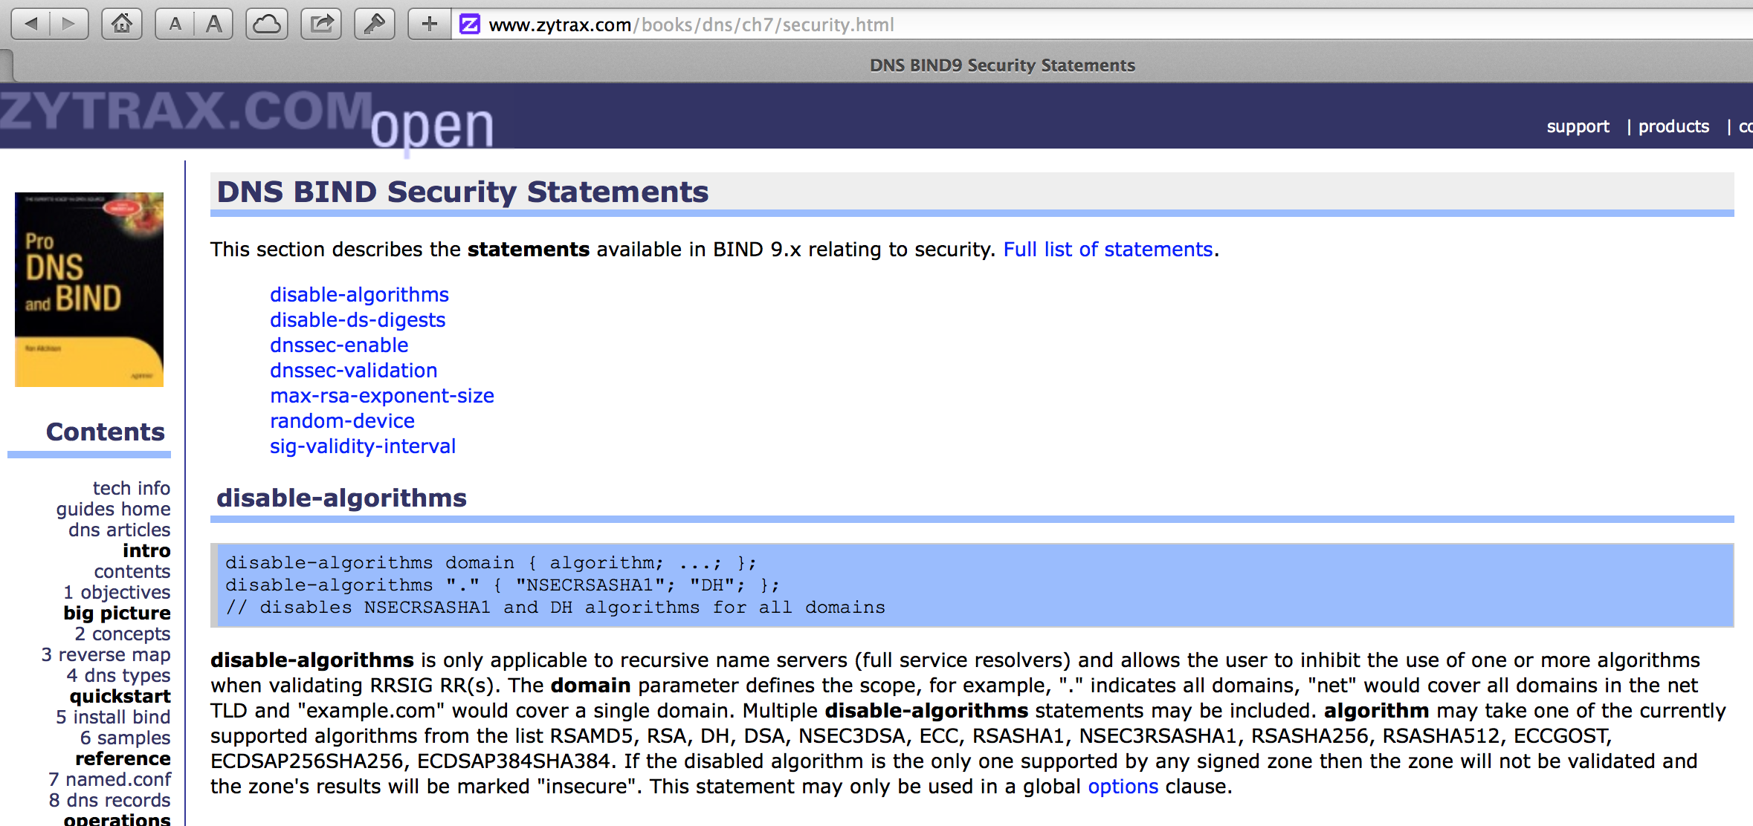
Is this old resolver code and/or a design choice?

Slide 24
Is ECC a viable crypto algorithm for the Root?
These results don’t look especially promising for the use of ECC in this context

Slide 25
Next steps
If we used ECC in the validation path, not at the terminal zone, would we see a similar outcome?
What are the behaviours of resolvers when encountering an unknown crypto algorithm? Should we experiment with other algorithm code values?

Slide 26
Questions?

